Slide 1
Test Rig
for the
Development & Testing
of the
Core Flight System Software Products
May 2022

Slide 2
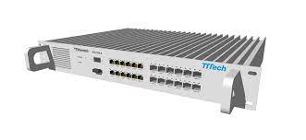
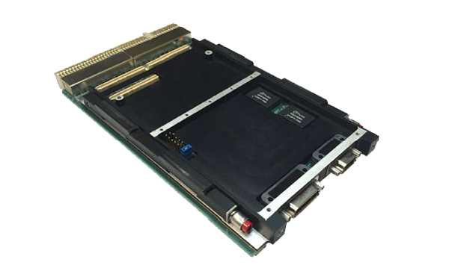

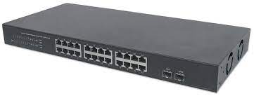
Network Connection
TTE
Switch
Target
Platform
#1
Target
Platform
#2
Sim
Host
Network
Switch
Legends:
Red boxes are target hardware
Black boxes are test-supporting hardware

Slide 3
Hardware Description
TTE Switch
Model: Lab Space
Firmware: v3.1.2
Target Platform #1
Processor: AiTech SP0-S
1024M SDRAM
OS: VxWorks v6.9
TTE Card: cPCI
TTE ES Driver: v3.101.00
TTE COM: v3.101.00
Target Platform #2
Processor: AiTech SP0-S
1024M SDRAM
OS: VxWorks v6.9
TTE Card: cPCI
TTE ES Driver: v3.101.00
TTE COM: v3.101.00
Sim Host
Processor: 8-core Xeon E5
126G RAM
OS: CentOS 7.9.2009
TTE Card: PCIe
TTE ES Driver: 3.2.1
Network Switch
Model: WS-C2960X-24TS-L
Software: 15.0(2a)EX5
Legends:
Red boxes are target hardware
Black boxes are test-supporting hardware

Slide 4
TTE Virtual Link Configurations
TTE Switch
Target Platform #1
(ES_3)
Target Platform #2
(ES_2)
Sim Host
(ES_1)
BE_1000
BE_1001
BE_1002
TT_100(MAC_S)
TT_101(MAC_Q)
RC_102(MAC_S)
RC_103(MAC_Q)
TT_200(MAC_S)
TT_201(MAC_Q)
RC_202(MAC_S)
RC_203(MAC_Q)
TT_300(MAC_S)
TT_301(MAC_Q)
RC_302(MAC_S)
RC_303(MAC_Q)
RC_10(IP_Q)
RC_20(IP_Q)
RC_30(IP_Q)
TT_123(IP_S)
TT_213(IP_S)
TT_312(IP_S)
BE_1000
BE_1001
BE_1002
TT_100(MAC_S)
TT_101(MAC_Q)
RC_102(MAC_S)
RC_103(MAC_Q)
TT_200(MAC_S)
TT_201(MAC_Q)
RC_202(MAC_S)
RC_203(MAC_Q)
TT_300(MAC_S)
TT_301(MAC_Q)
RC_302(MAC_S)
RC_303(MAC_Q)
RC_10(IP_Q)
RC_20(IP_Q)
RC_30(IP_Q)
TT_123(IP_S)
TT_213(IP_S)
TT_312(IP_S)
BE_1000
BE_1001
BE_1002
TT_100(MAC_S)
TT_101(MAC_Q)
RC_102(MAC_S)
RC_103(MAC_Q)
TT_200(MAC_S)
TT_201(MAC_Q)
RC_202(MAC_S)
RC_203(MAC_Q)
TT_300(MAC_S)
TT_301(MAC_Q)
RC_302(MAC_S)
RC_303(MAC_Q)
RC_10(IP_Q)
RC_20(IP_Q)
RC_30(IP_Q)
TT_123(IP_S)
TT_213(IP_S)
TT_312(IP_S)
Legends:
Bold text with gray background VLs are output VLs for that ES;
i.e., the ES is the sender of those VLs.
Regular text with no background VLs are input VLs for that ES;
i.e., the ES is the receiver of those VLs.
Notes:
TTE VLs are uni-directional.
Look for matching VL names to trace senders and receivers.
The configuration is for broadcasting of messages.
Network Switch

Slide 5
Software Load
TTE Switch
Target Platform #1
(vx_es2 cFS build)
Target Platform #2
(vx_es3 cFS build)
Sim Host
(lx_es1 cFS build)
cfe-core
io_lib
ci
to
tte_lib
tte_mgr
sch_tt
sbng
vs
cs
cf
ds
fm
hk
hs
lc
md
mm
sc
cfe-core
io_lib
ci
to
tte_lib
tte_mgr
sch_tt
sbng
vs
cs
cf
ds
fm
hk
hs
lc
md
mm
sc
cfe-core
io_lib
ci
to
tte_lib
tte_mgr
sch_tt
sbng
vs
cs
cf
ds
fm
hk
hs
lc
md
mm
sc
Network Switch
Legends:
Red boxes are target hardware
Black boxes are test-supporting hardware

